Slide 1

DESIGN AND FABRICATION OF EXOSKELETON
ME_17CD021
Under the supervision of
DR.B.V. DHARMENDRA
170070177 Hemanth .S
170070248 Saikumar .D

Slide 2
Abstract
Exoskeletons can be used in wide range of areas like medical, army, manufacturing, etc. exoskeletons are designed to assist and protect the wearer. Depending on the situation they may be used to protect soldiers and construction workers, aid the survival of people in dangerous environments, or assist patients in rehabilitation. In this Project we are going to design an Exoskeleton which will be light weight, durable, efficient to lift weights. We will be using Pneumatic actuators as muscles for this Exoskeleton.

Slide 3
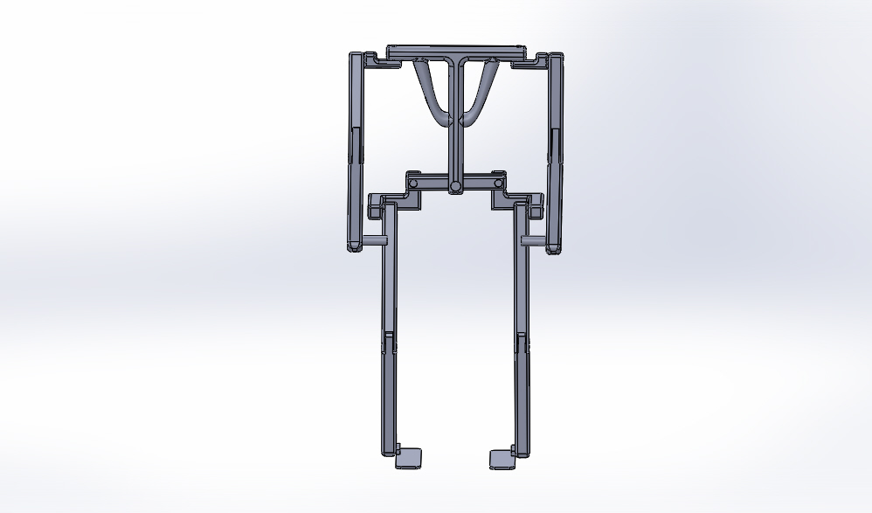
First stage of Design

Slide 4
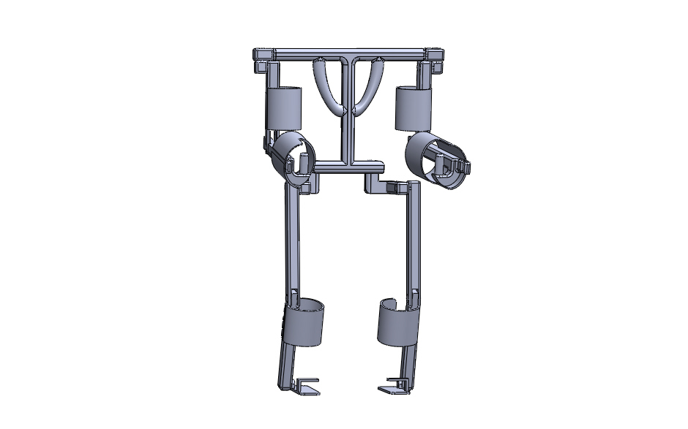
Final Design

Slide 5
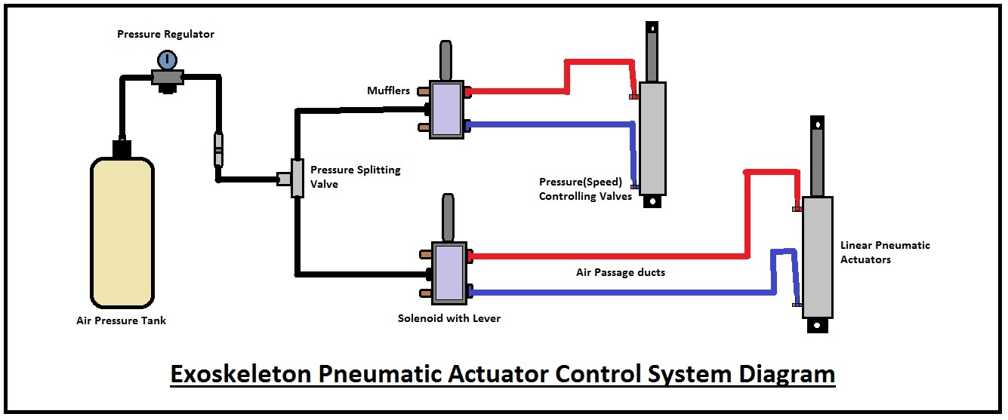
Pneumatic actuator Control system.

Slide 6
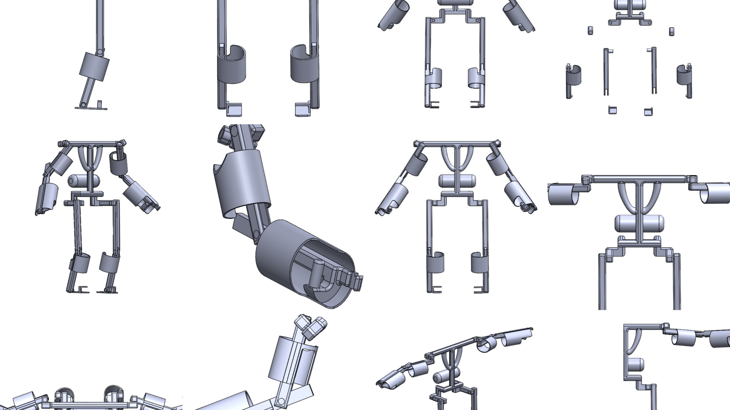
Manufacturing
Step 1: Design

Slide 7
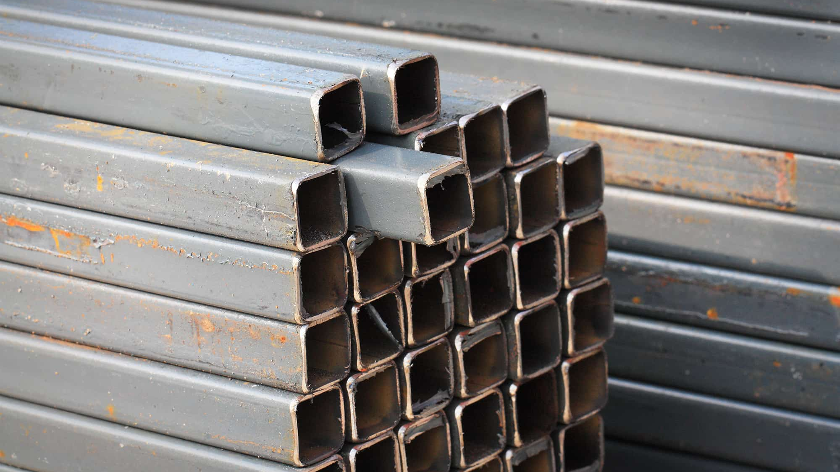
Step 2: Material collection

Slide 8
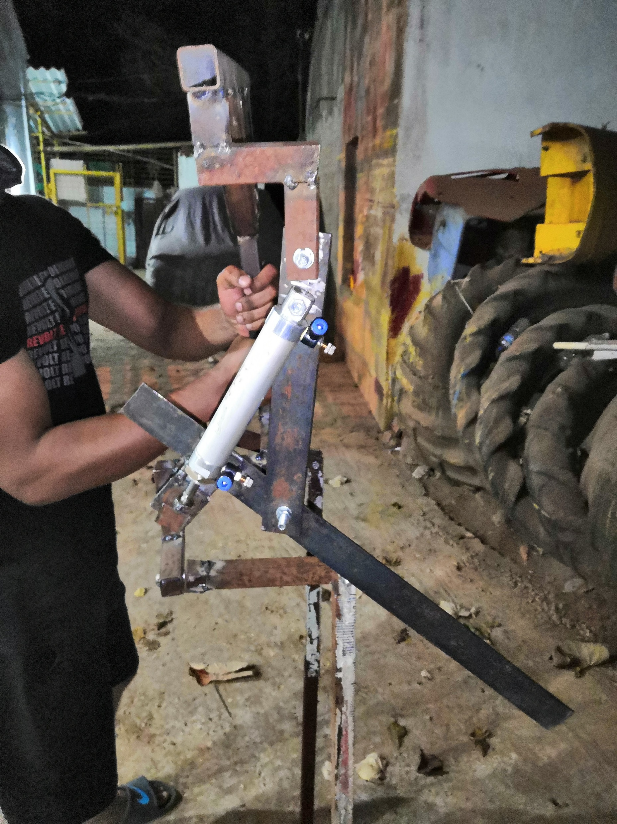
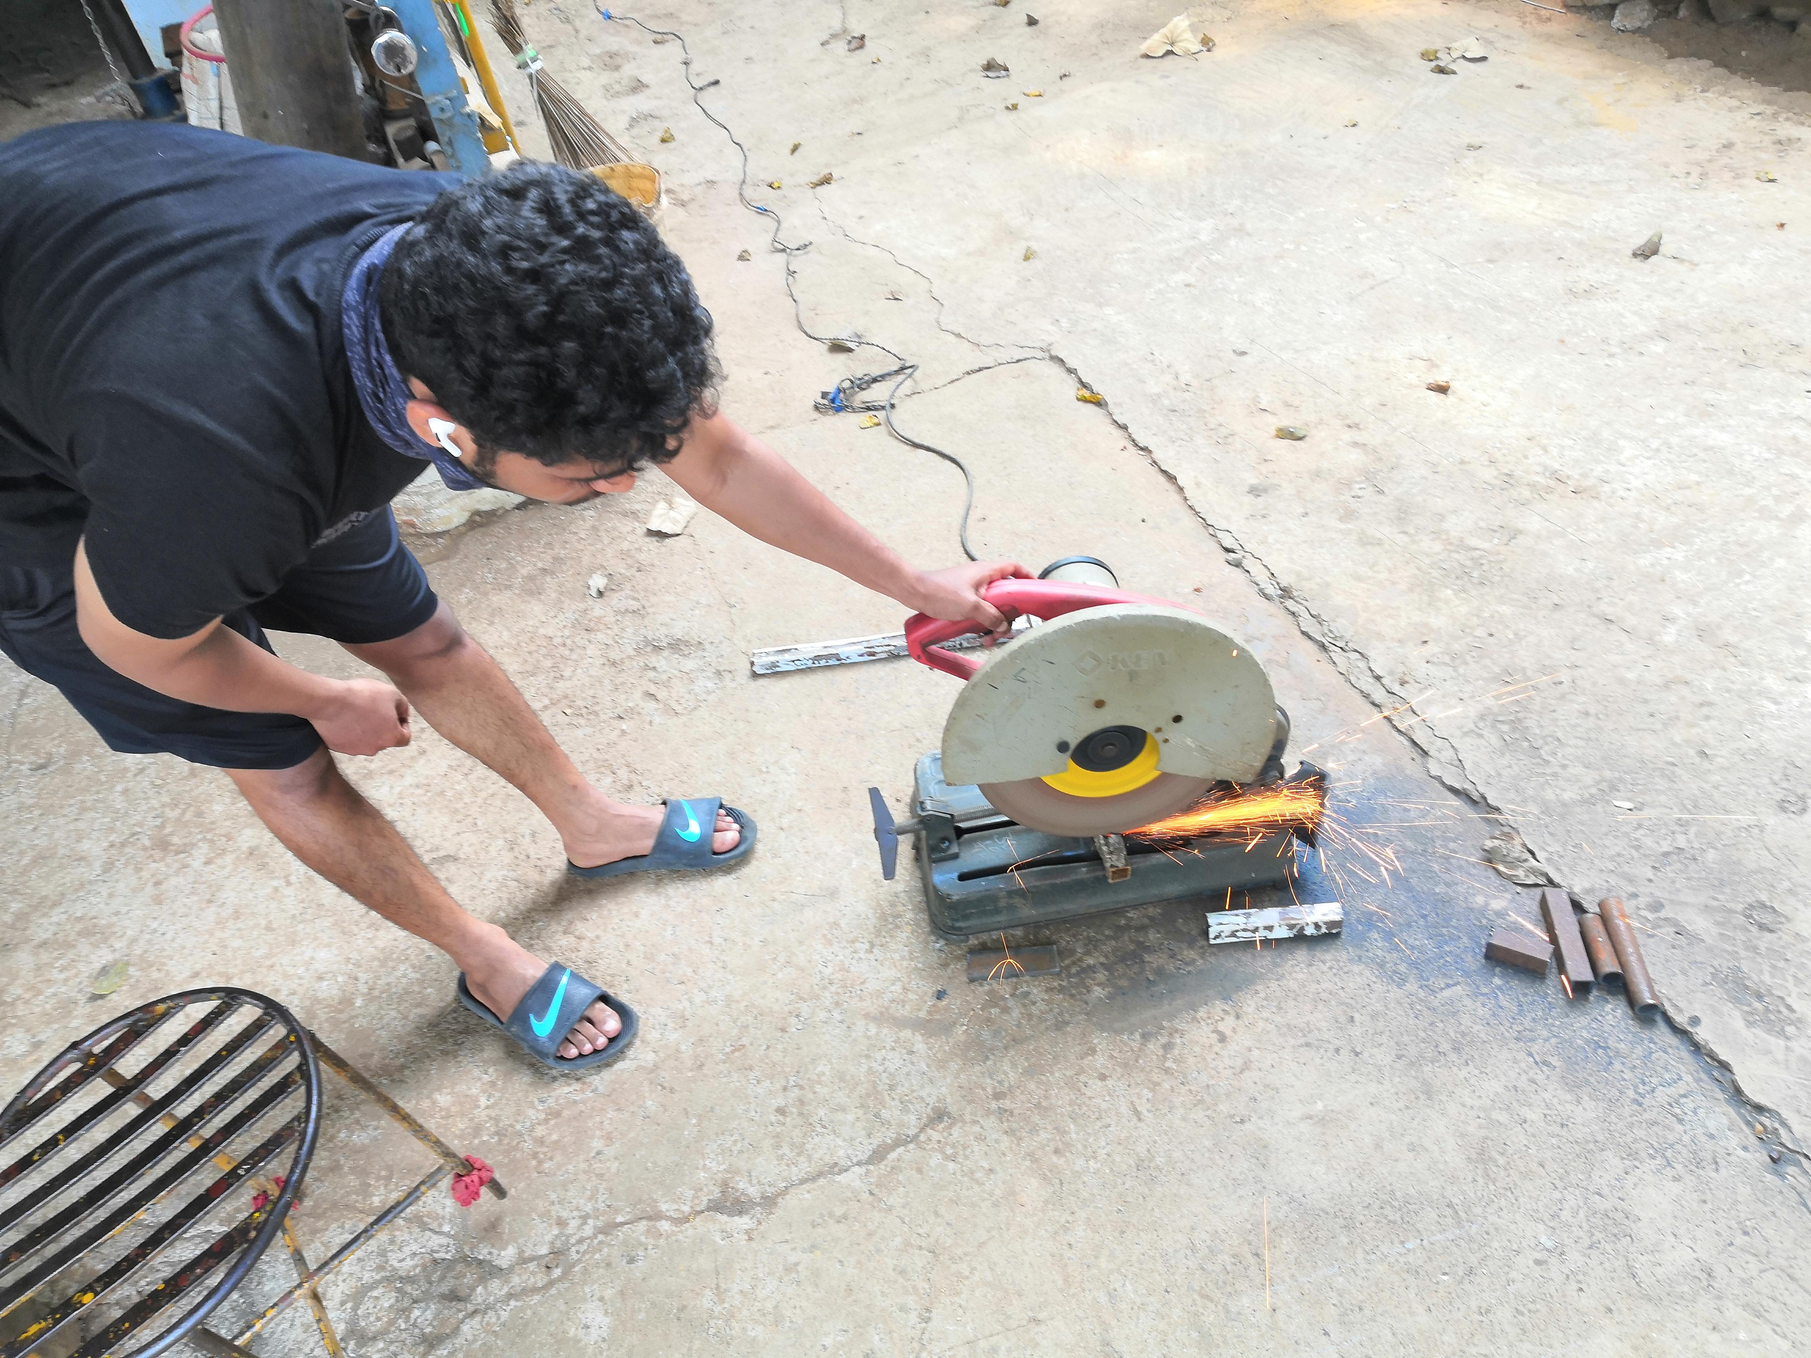
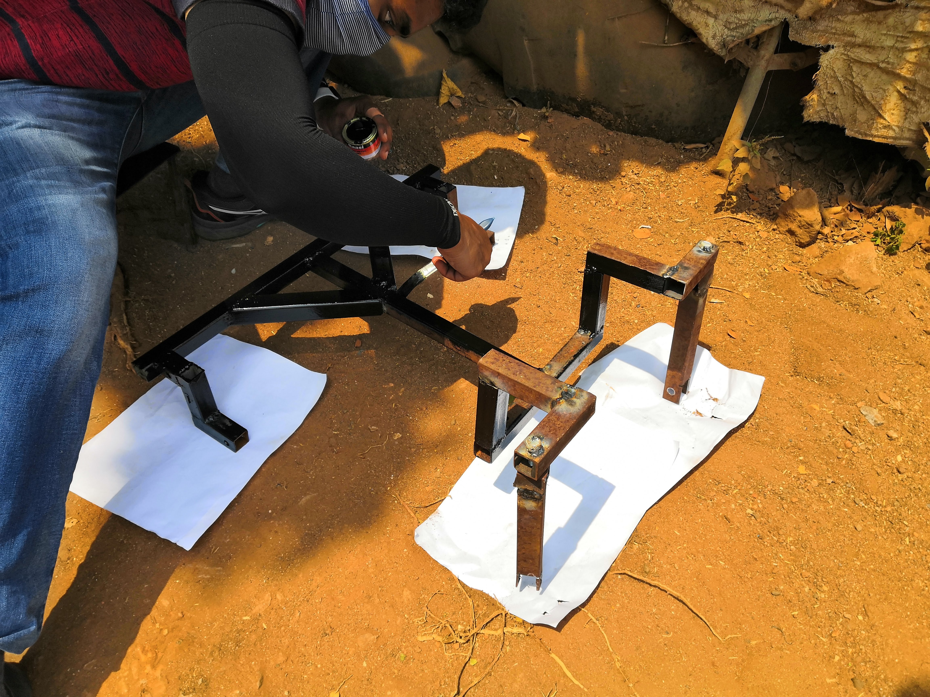
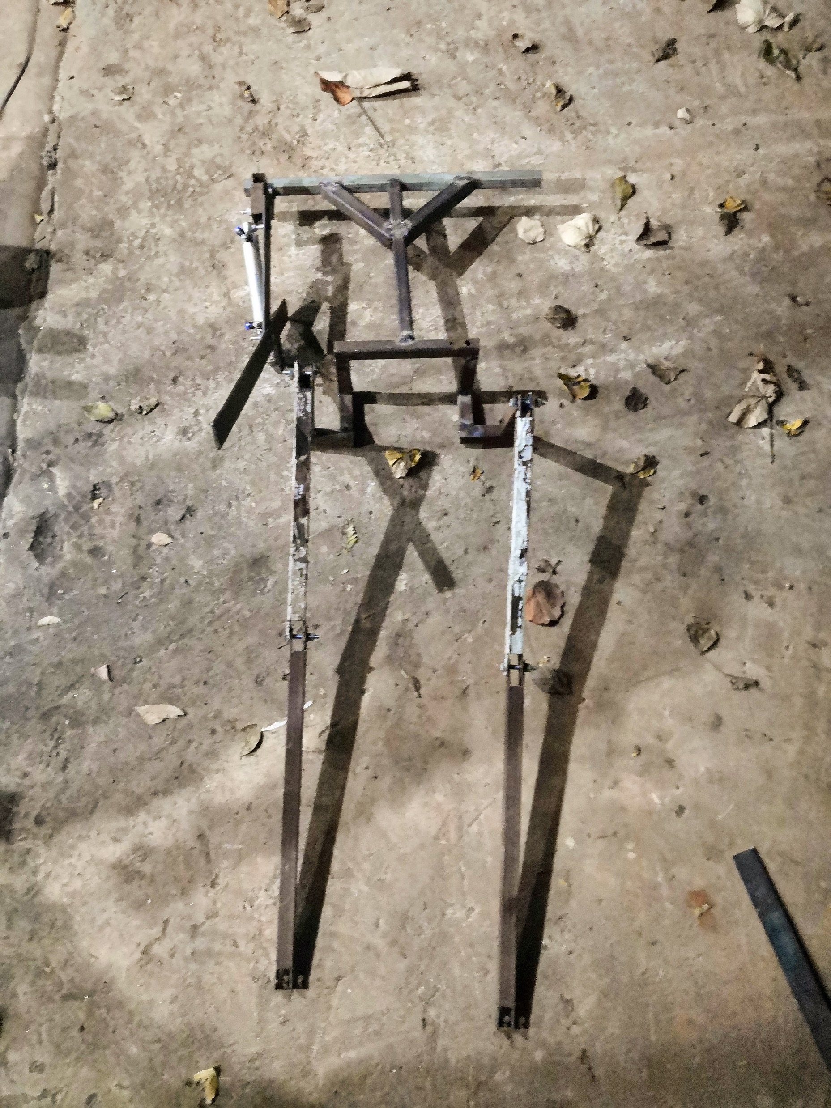
Step 3: Cutting, Welding, Drilling,

Slide 9
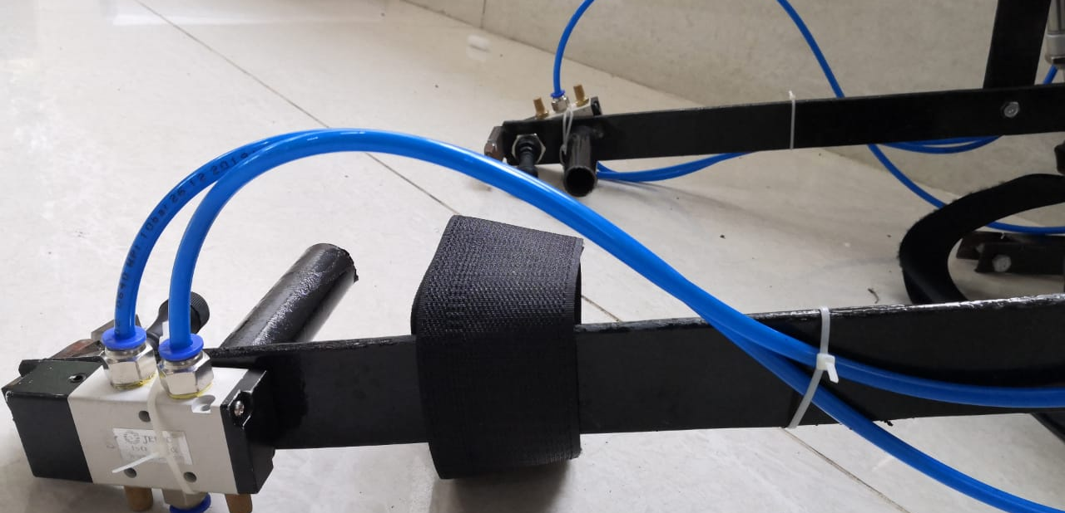
Step 4: Assembling

Slide 10
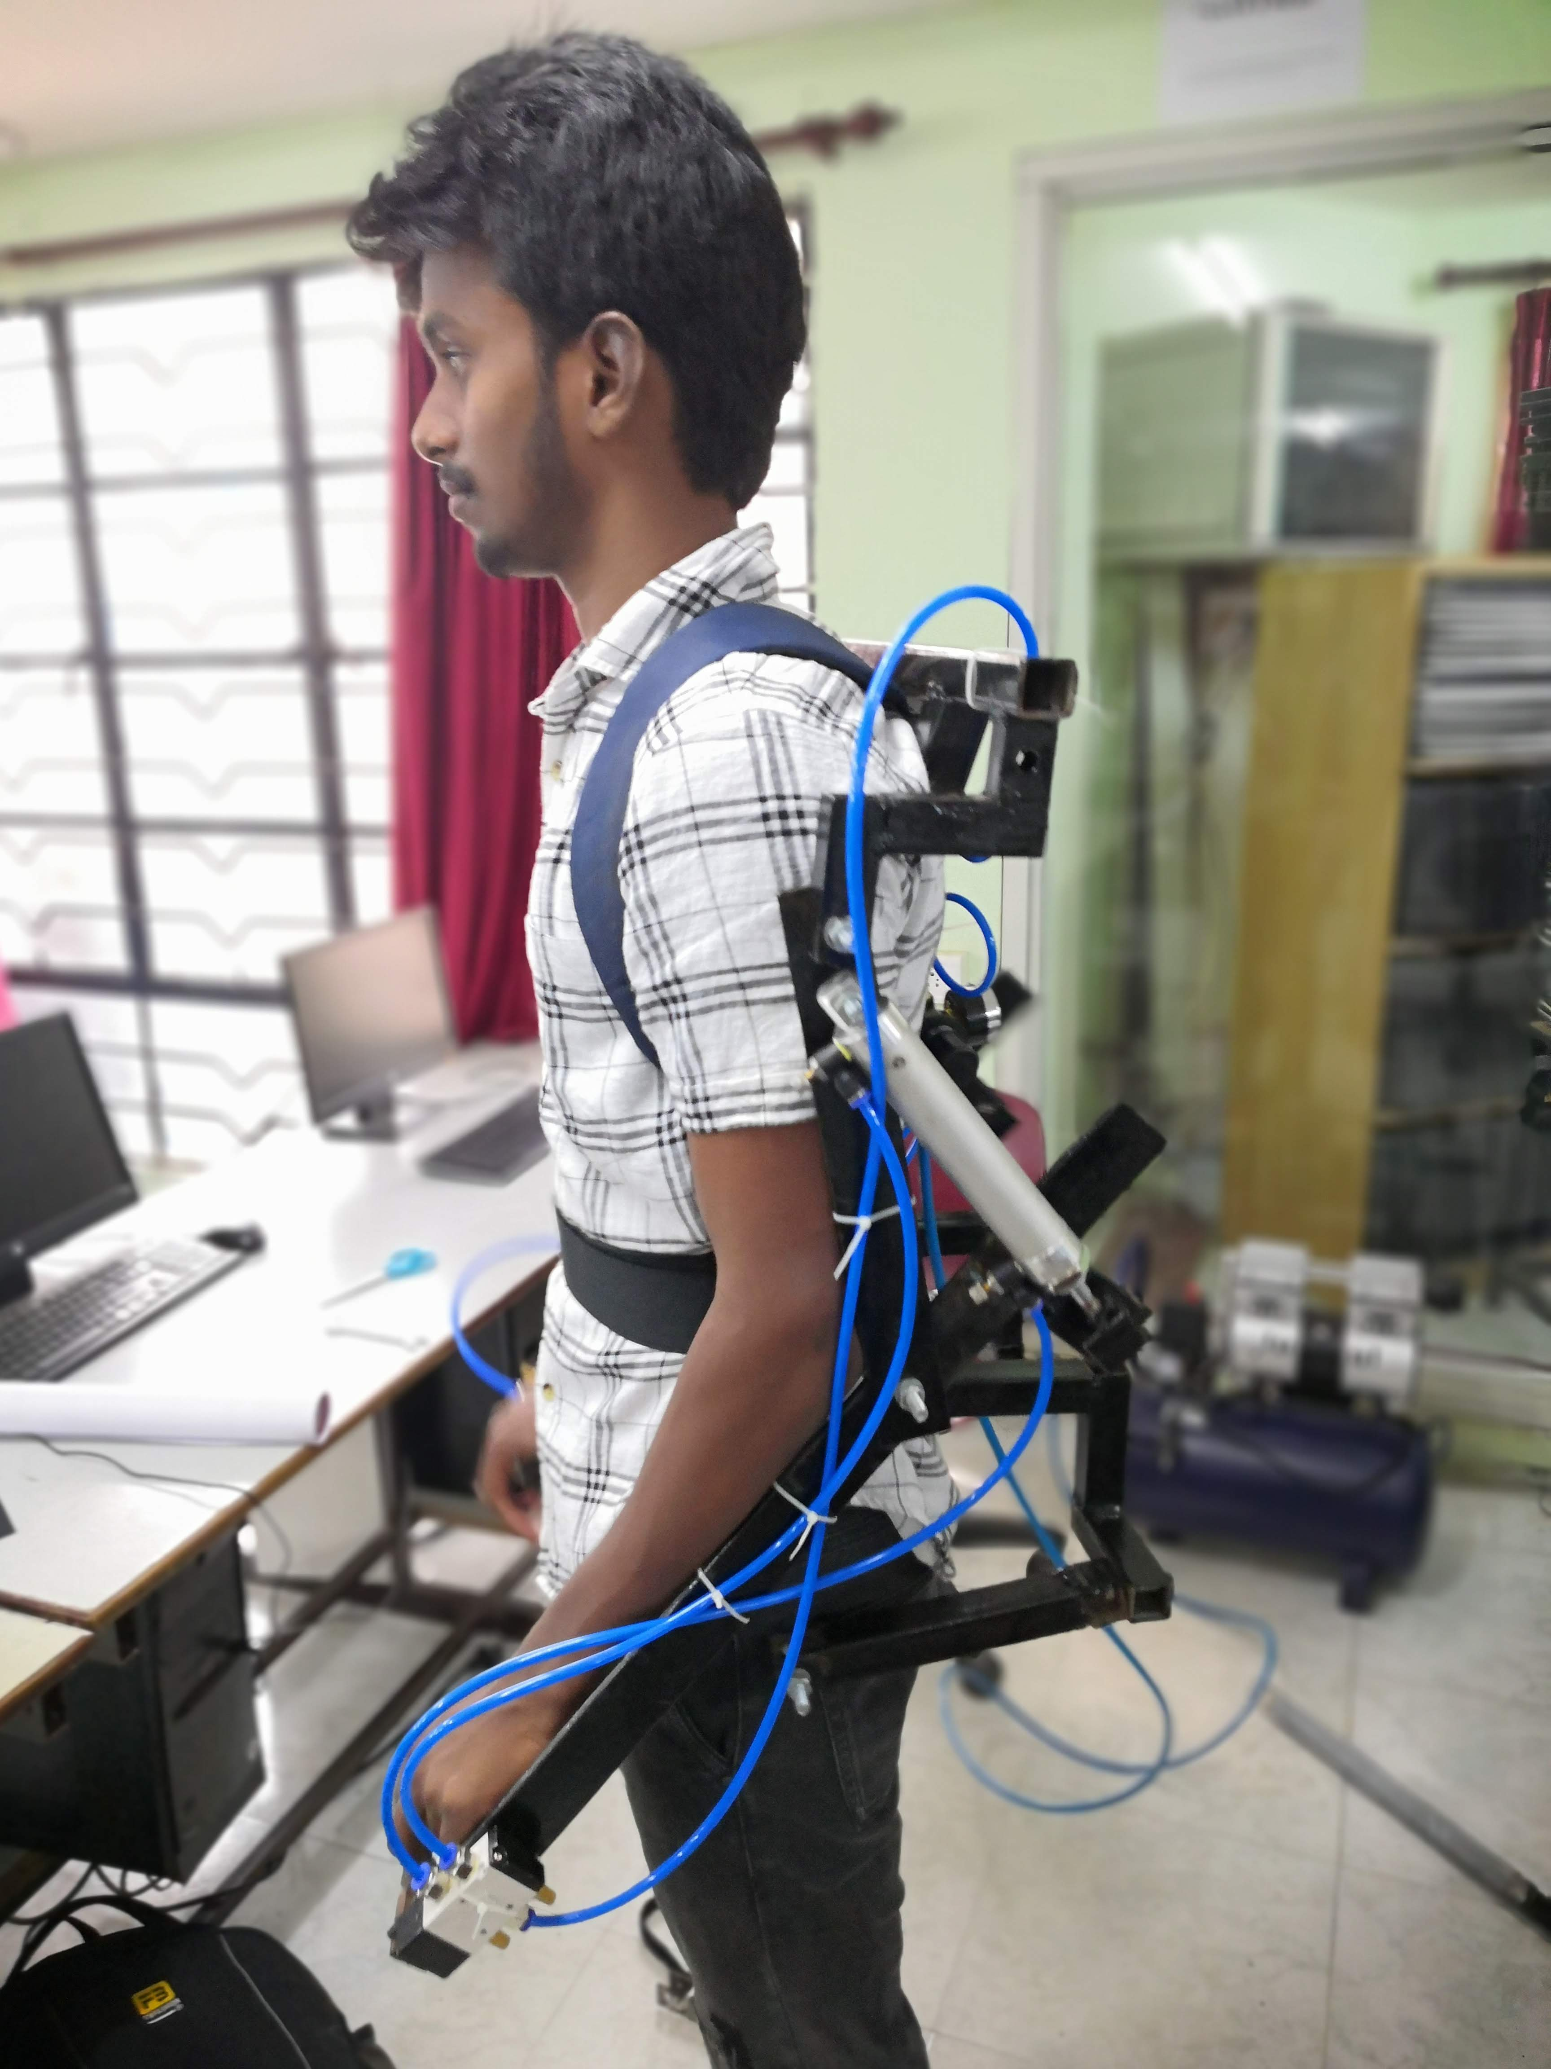
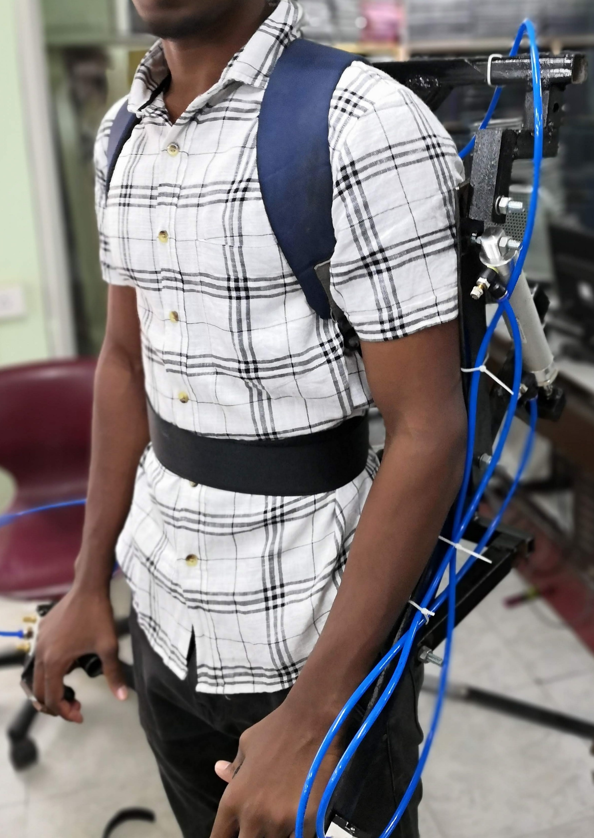
Final Output

Slide 11

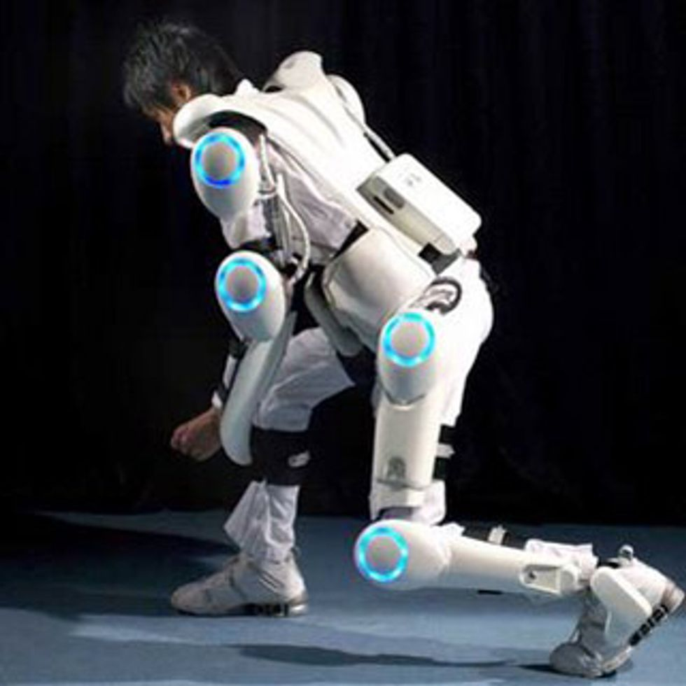
Future Scope
Exoskeletons will play a major role in future. It can be used by employees in manufacturing field, assist patients in rehabilitation, army soldiers can lift heavy guns easily, it can also be used by astronauts in space journey, and old aged people, etc.

Slide 12

Thankyou

